Slide 1


AIT301
SPEECH RECOGNITION
GROUP 6
LEONG YAO CHENG AIT2209942
KWAH WEN YAO AIT2209940
TAY RE ZEN AIT2209954
LIEW CHEAH MING AIT2209608
Group 6

Slide 2
Page
Group 6
01
INTRODUCTION

Slide 3

Page
Group 6
SPEECH RECOGNITION
02
Speech recognition is at the forefront of modern AI, enabling virtual assistants and accessibility tools

Slide 4
Page
Group 6
03
HOWEVER...
Speech systems lack emotional understanding, a critical component for empathetic and effective communication

Slide 5

Page
Group 6
04
OBJECTIVE
Our project builds on an existing speech-to-text model, enhancing it with a novel emotion recognition system
To create a hybrid system that can transcribe speech and classify emotions simultaneously

Slide 6
Group 6
Page
05
PROJECT OVERVIEW

Slide 7
Group 6
CORE IDEA
This project introduces a hybrid CNN-GRU model that integrates speech-to-text recognition with emotion recognition.
The goal is to improve human-computer interaction by not only transcribing speech but also detecting the speaker's emotional state.
Such a system can have applications in mental health, customer service, and courtroom transcription.
Page
06

Slide 8
Borcelle Tech
DATASETS USED
CREMA-D: Over 7,400 audio clips with six emotions.
TESS: 2,800 audio clips across seven emotions.
SAVEE: 120 utterances per speaker, covering seven emotions.
RAVDESS: 1,440 audio files with seven emotions and two intensity levels.
Page
07

Slide 9
Group 6
KEY COMPONENT
Feature Extraction
Model Architecture
Training Process
Validation
Speech-to-Text: Based on DeepSpeech, using Convolutional, Recurrent, and Fully Connected layers.
Speech-to-Text achieved a Word Error Rate (WER) of 9.410, leveraging AdamW optimizer and CTC loss.
Verified alignment of audio and transcript data.
Metrics like WER and Character Error Rate (CER) were used to evaluate performance.
Techniques like Mel Spectrograms, MFCCs, and Chroma Features were used to represent audio data in a meaningful way
Emotion Recognition: A novel CNN-GRU hybrid model capturing temporal and contextual data for classifying seven emotions.
Emotion Recognition achieved 73% accuracy with advanced preprocessing and data augmentation techniques.
Page
08

Slide 10
Page
Group 6
09
DEMO

Slide 11
Page
Group 6
10
RESULTS

Slide 12
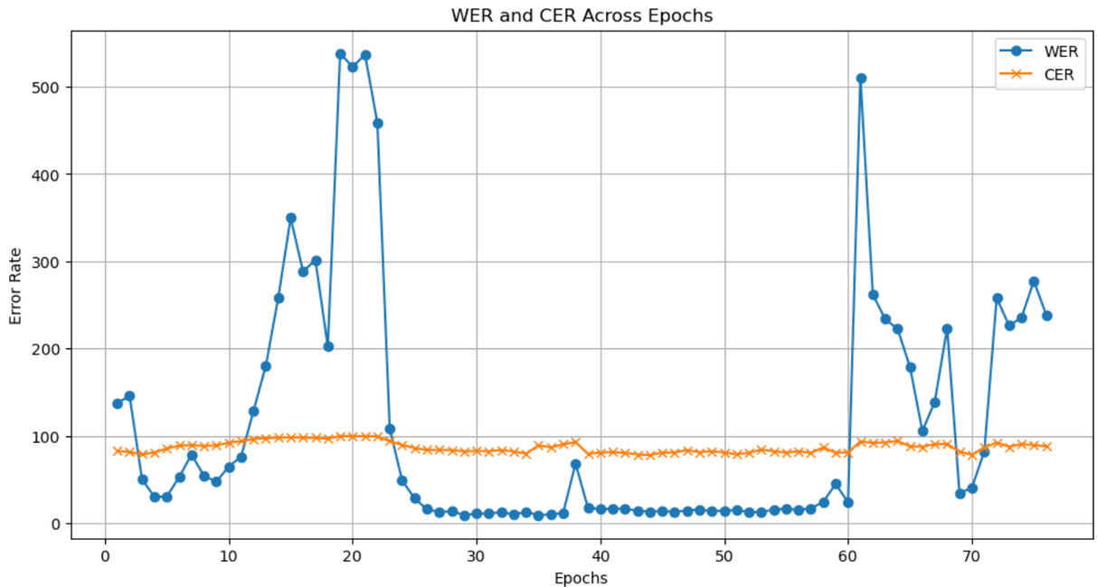
RESULTS
Page
Group 6
11
SPEECH TO TEXT PERFORMANCE
Word Error Rate and Character Error Rate
The blue line represents the Word Error Rate and achieves lowest value of 9.41
The orange line represents the Character Error Rate, which remains stable at around 89

Slide 13
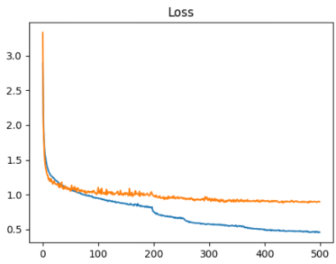
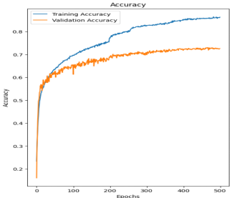
RESULTS
Page
Group 6
12
EMOTION RECOGNITION PERFORMANCE
Training and Validation Loss
Training and Validation Accuracy
At Borcelle Tech, our mission is to harness the power of Artificial Intelligence to create innovative solutions that drive progress, enhance efficiency, and improve lives.
Our vision is to be a global leader in Artificial Intelligence, recognized for our innovative solutions, ethical practices, and positive impact on society.

Slide 14
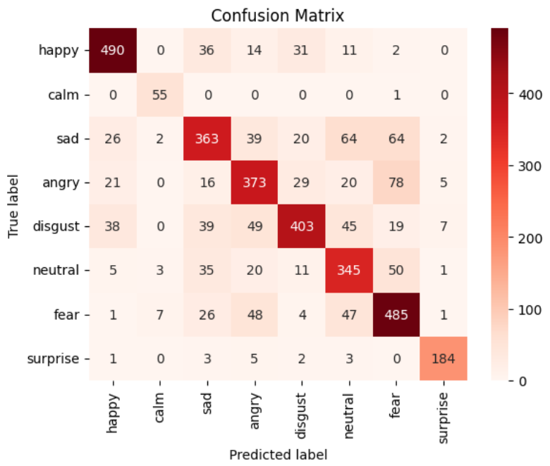
RESULTS
Page
Group 6
13
EMOTION RECOGNITION PERFORMANCE
Confusion Matrix
Performs well for most of the emotions such as neutral, calm, surprise, and happy
Difficulties in distinguishing emotions such as sad, disgust, and fear
due to overlapping acoustic features between these emotions

Slide 15
Page
Group 6
14
CHALLENGES

Slide 16


Page
Borcelle Tech
15
CHALLENGES
High amount of low frequency word and cause lack completeness of dataset
Model might be stuck producing the same character-level mistakes
Sparsity of training data, such as calm and surprise
Lack of diversity in data, specific accent and age group in controlled recording conditions
Computational limitations, training deep learning model on our large dataset, is very computationally expensive

Slide 17



LESSON LEARNED
Page
Borcelle Tech
16
Critical role that dataset quality and balance play in training a robust model
Efficient resource management is critical, especially for resource-intensive deep learning projects
Visualization is a powerful tool for diagnosing issues and communicating results effectively
Designing for scalability and real-time performance requires early consideration of computational efficiency.

Slide 18
Page
Group 6
17
CONCLUSION

Slide 19


Group 6
Page
18
CONCLUSION
Utilising advanced computational resources such as GPUs or TPUs may greatly improve model training and inference times
Improving dataset diversity and quality is critical to increasing the model's robustness.
Incorporate datasets with conversational speech and recordings from diverse demographic groups
Generative Adversarial Networks (GANs) to synthetically generate samples for underrepresented emotion classes.
Implement real-time processing capabilities

Slide 20

Page
Group 6
19
THANK YOU

